Slide 1
Info Meeting
Tuesday, August 29
6:00 PM

Slide 2
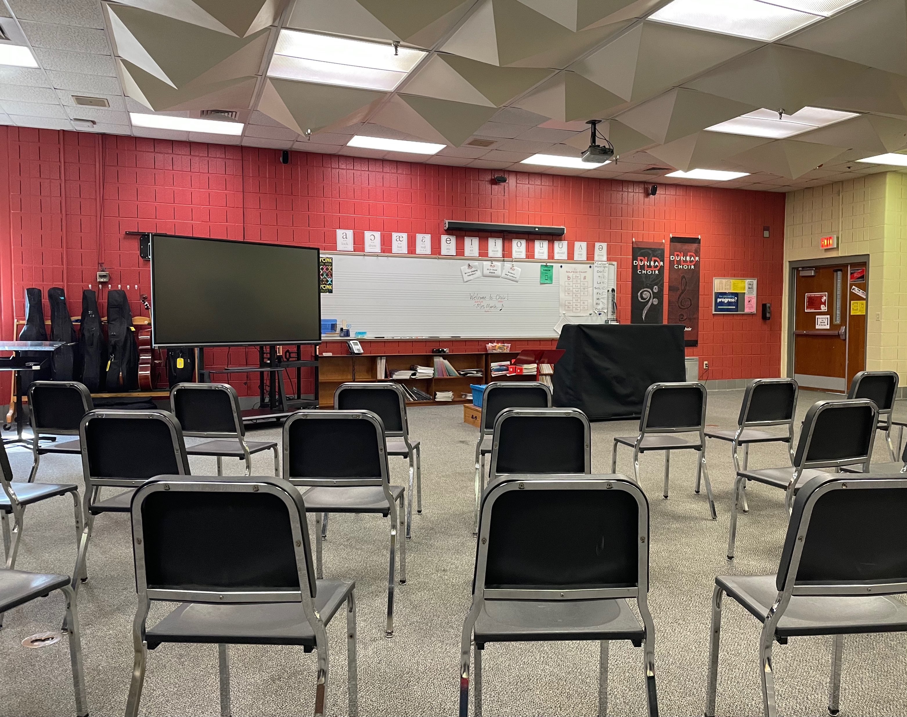
Introduction
Mrs. Tiffany Marsh
Chorus
Beginning Piano & Piano II
AP Music Theory
Dunbar Choral/Vocal Program
Concert Choir (A1)
Chamber Choir (A2)
After school Pop Ensemble, M2 voice lessons, and assists with the vocal music for the musicals

Slide 3
Expectations
Learn music & singing skills through singing.
Leadership and ensemble building.
Enjoyment!
Class Focal Points:
Music literacy/reading
Vocal development
Exposure to different styles of music
Music theory
Leadership/Confidence

Slide 4
Getting Started
HANDBOOK/SYLLABUS
OTHER FORMS
Students reviewed first week of classes
Expectations for class/ensemble, SBG, attendance, attire, etc.
This document is available under the syllabus tab in Canvas and was sent electronically via email to families
23-24 Calendar
Semester permission slip – will go out next week
Pick-a-Date Calendar Fundraiser – running through this week

Slide 5
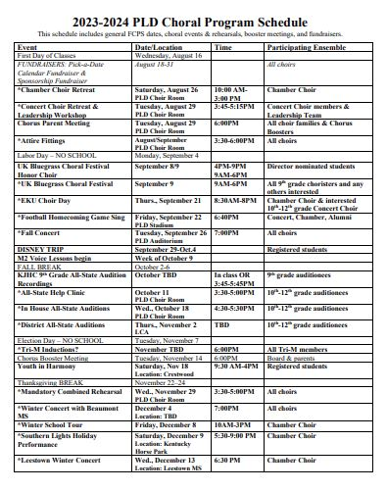
23-24
PLD
Choir Schedule

Slide 6
23-24 PLD Choir Schedule
Annual
SPEciAL for 23-24
PLD Season Choral Concerts
Fall Concert – September 26
Winter Concert – December 4
Spring Picnic on the Dawgwood
UK Bluegrass Choral Festival
Upcoming! September 9
EKU Choir Day
Upcoming! September 21
Football Homecoming National Anthem
Upcoming! September 22
UK Male Chorus Day – January
UofL Honor Choir – January
KMEA/KJHC All-State – February
Solo & Ensemble – February
Chamber Choir Festival - February
District Choral Assessment – March
Awards Ceremony & Senior Send-off – May
Disney Trip
September 29-October 4
Pre-Trip Meeting – September 11

Slide 7
Attendance
Daily Attendance
Attendance is crucial for every choir member. Due to the nature of the course, when a student is absent from school, he/she misses rehearsal and explanations that cannot be made up. In addition, the entire choir suffers because that student was not in school to learn his/her part along with the rest of the choir.
Performance Attendance
This is a performing organization. We work constantly to be prepared to perform. Every member of the choir plays a vital role in the success of the entire organization. There is no other way as a director to duplicate a performance for the student who is absent. Due to this, the following policies regarding performance attendance apply:
All performances on the schedule at the beginning of the semester, as well as those with at least four weeks notice, are required performances, marked with an * on the schedule and categorized as a SUMMATIVE ASSESSMENT. Should you have a conflict that cannot be resolved, notify Mrs. Marsh at least two weeks ahead of time verbally and IN WRITING.

Slide 8
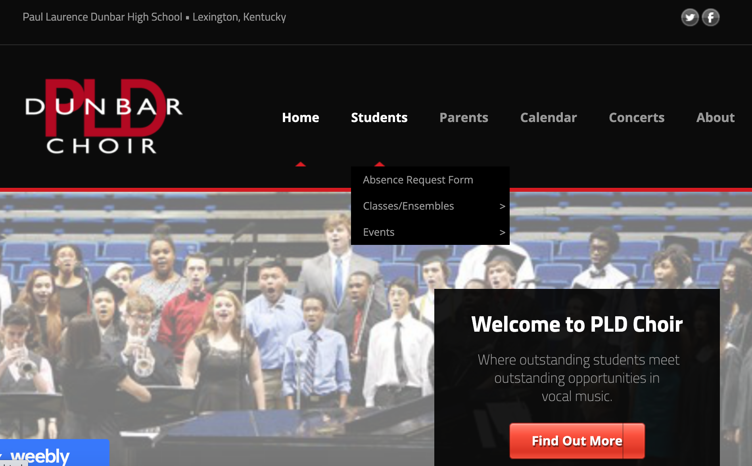
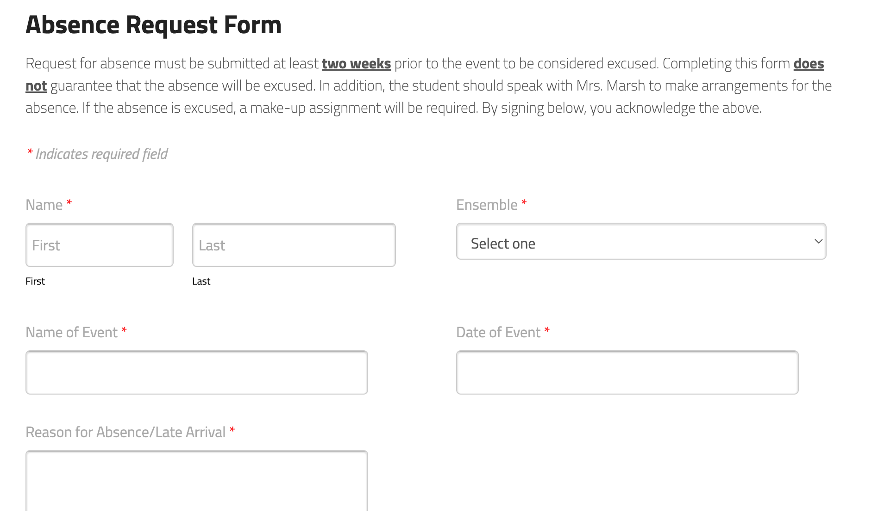
Absence Request Form

Slide 9
Communication
PLD Chorus website www.pldchoir.org
23-24 schedule, class forms, booster info, fundraising
Paul Laurence Dunbar Choir Facebook
Twitter: @pldchoir
Instagram: choirpld
Sign up for REMIND
Remind may be used with students, but per the Remind TOS: ‘Before using Remind, you need to be at least 18 years old, and agree to these terms. If you’re under 18, a parent or guardian needs to agree to these terms for you.’ This means that although approved, parents must be notified about the use of Remind and approve for the student to participate.

Slide 10
REMIND
Concert (A1)
Text @pldconcert to 81010
Chamber (A2)
Text @pldchamber to 81010
I encourage parents to join!

Slide 11
M2 (Mastering Musicianship)
Voice Lessons
How to sign up
Provided at PLD in the choir room
Mondays, Tuesdays & Wednesdays
3:30-6:30 PM
10 lessons/semester
Begins October 9
M2 Sign-up
$150/semester
10 lessons @ $15/lesson)
Cash or check made payable to PLD Choirs

Slide 12
Volunteer/Chaperone
FCPS Records Check
www.pldchoir.org/volunteer.html
Complete for any FCPS event/school.
Good for four years.

Slide 13
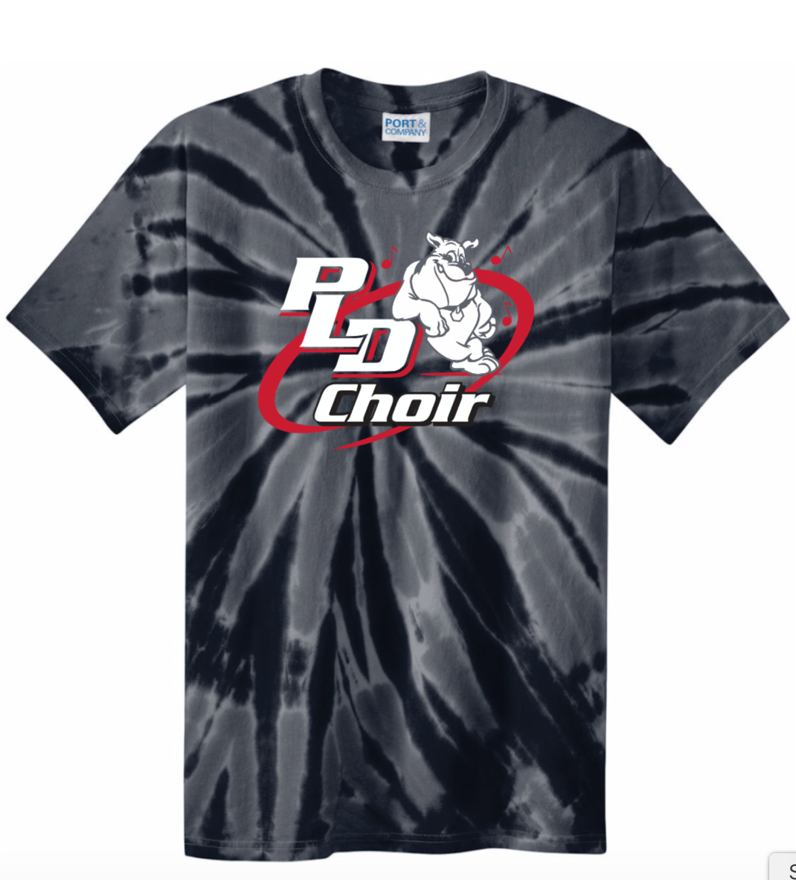
Concert Attire
Formal Concert Attire
Soprano/Altos: Black dress OR Black dress blouse & pant (plus black dress shoes)
Tenors/Basses: Black pants, black dress shirt, 2 ties (plus black dress shoes)
Casual Concert Attire
PLD Choir T-Shirt & no hole jeans (students provides) *If you have a need of assistance for jeans or black dress shoes, don’t hesitate to reach out

Slide 14
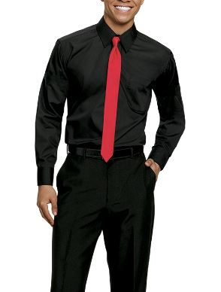
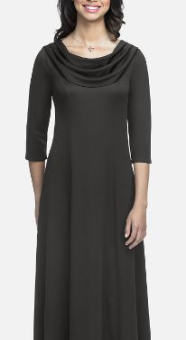
Concert Attire
Attire Chairpersons: Tara Lindgren & Tamara Robinson
Attire fitting will take place during your students class in the coming weeks.

Slide 15
Chorus Parent Help
SUPPORT THROUGH VOLUNTEER
SUPPORT THROUGH FUNDRAISING
Assist at events
Chaperone
Help with Fundraising
Booster Club
Booster Board
President – Jolinda Todd
Vice President – Katie Feola
Treasurer – Sarah Nally
Secretary – Lennie Underwood
Accounts Receivable – Victoria Vicary
At Large Committee – Tara Lindgren, Patti Neal, Ken Petrey, Tamara Robinson, Cyndi Stiltner, Jennifer Viele
Pick-a-Date Calendar Fundraiser
August
Sponsorship Campaign
September 5-20
Brick Oven Spirit Night
October TBD
World’s Finest Chocolate
January 8-31
Valentine Grams
February 6-13
Picnic on the Dawgwood
May 17

